Slide 1
VALLIAMMAL COLLAGE FOR WOMEN
TITLE: FITFLIX
TEAM ID : SWTID1741248771149816
TEAM LEADER : OVIYA S (oviyas22cs055@gmail.com)
TEAM MEMBERS
PAVITHRA J : pavithraj22cs056@gmail.com
PONNAMMAL R : ponnammalr39@gmail.com
PINDI ANUSHA : pindianusha22cs057@gmail.com

Slide 2
ROLE IN THE PROJECT
OVIYA S - Frontend Module
PAVITHRA J - External API Module
PONNAMMAL R - Security Module
PINDI ANUSHA - Backend/API Handling Module

Slide 3
INTRODUCTION
SB Fitzz is an innovative fitness app designed to transform exercise engagement.
Offers an intuitive user experience and a feature-rich platform.
Target Audience: Fitness enthusiasts and workout professionals.
A web-based fitness platform providing structured exercise guidance based on body parts and equipment.

Slide 4
PROBLEM STATEMENT
Users struggle to find structured, easy-to-follow workout plans.
Existing resources are scattered, unstructured, or behind paywalls.
Need for a user-friendly fitness solution with categorized workouts.
Most fitness apps focus on solo workouts, missing collaborative and social features.

Slide 5
PROPOSED SOLUTION
A React.js-based web application for discovering exercises.
Free and structured access to categorized workouts.
Real-time data retrieval from ExerciseDB API.
Responsive UI for seamless user experience.
Advanced search features to help users easily discover workouts.

Slide 6
GOALS AND OBJECTIVES
The overarching aim of SB Fitzz is to offer an accessible platform tailored for individuals passionate about fitness, exercise, and holistic well-being. Our key objectives are as follows:
1.User-Friendly Experience
2.Comprehensive Exercise
3.ManagementTechnology Stack

Slide 7
SOLUTION ARCHITECTURE
Frontend: React.js, CSS, React Fa Icons.
External API: ExerciseDB (via RapidAPI).
Security: HTTPS, API Key Authentication.
Backend/API Handling: JavaScript, Axios.

Slide 8
USER STORIES AND PRIORITISATION
Browse exercises by body part (High Priority - Sprint 1).
Browse by equipment (High Priority - Sprint 1).
View detailed exercise info (High Priority - Sprint 1).
Watch related YouTube videos (Low Priority - Sprint 2).
Home page navigation (High Priority - Sprint 1).

Slide 9
KEY BENEFITS AND UNIQUENESS
Free and structured fitness guidance.
Seamless integration with Exercise DB API.
Categorized and searchable workouts.
Scalable and responsive UI for enhanced user experience.

Slide 10
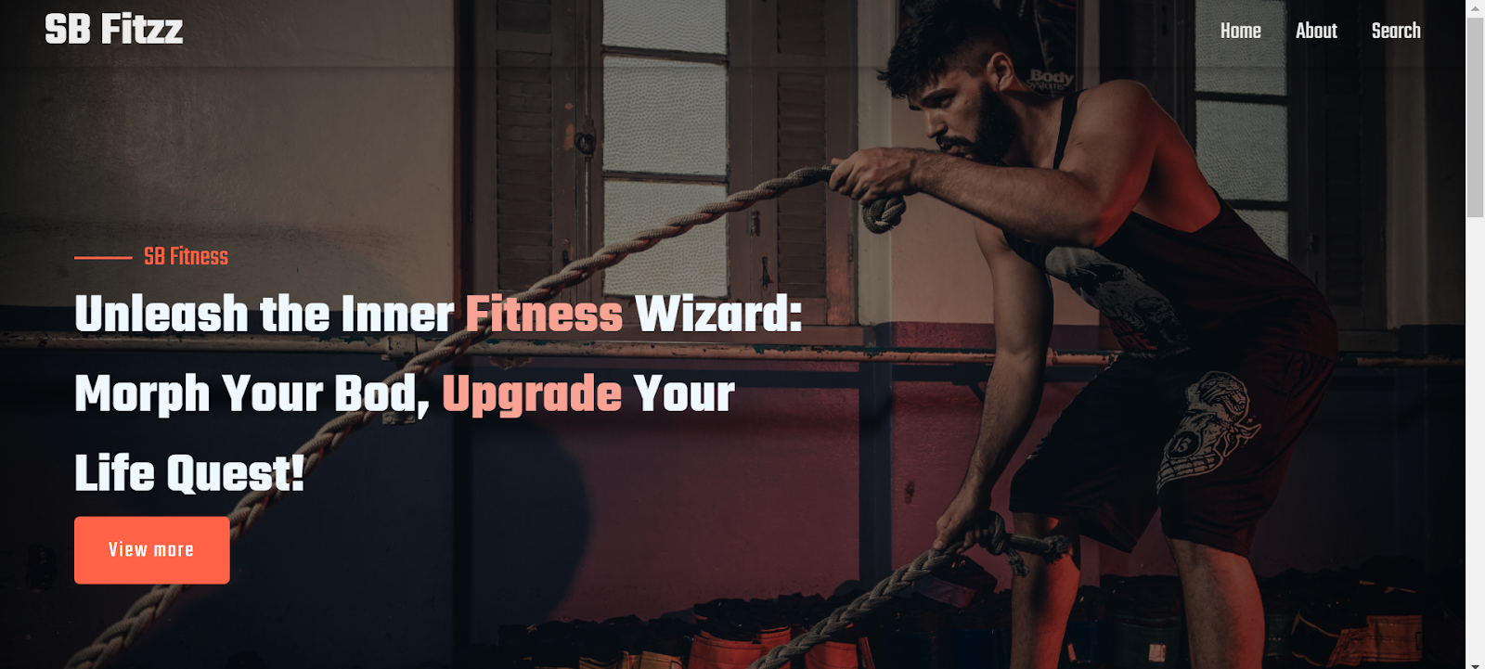
OUTPUT SCREENSHOT

Slide 11
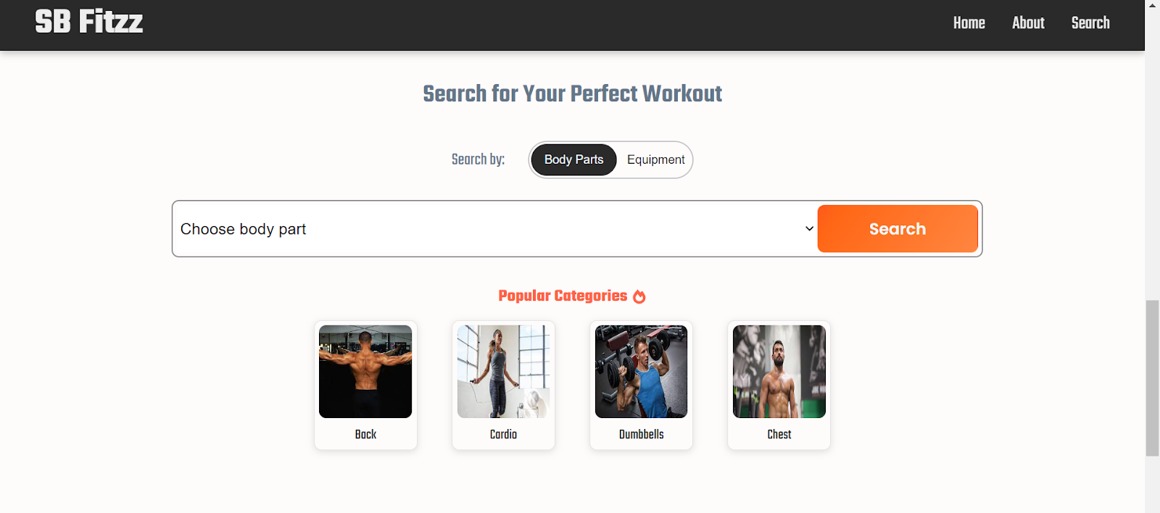

Slide 12
FUTURE ENHANCEMENT
Community-Driven Motivation – Encourages users to connect, share, and stay inspired on their fitness journey.
Seamless Integration of Technology & Fitness – Combining innovation with established exercise principles for an enhanced fitness experience.
Empowering a Healthier Lifestyle – SB Fitzz is the future of fitness exploration, making workouts accessible, engaging, and effective.

Slide 13
CONCLUSION
SB Fitzz is more than just a fitness app—it’s a revolutionary platform that transforms the way individuals engage with exercise. By seamlessly blending technology with the principles of fitness, SB Fitzz empowers users to explore, customize, and share their workout experiences like never before. As we continue to evolve, SB Fitzz remains committed to innovation, fostering a space where fitness is not just a routine but a shared journey of growth, motivation, and well-being. Join us and be part of the future of fitness exploration—where every tap brings you closer to a healthier, stronger you!

Slide 14
THANK YOU

